Slide 1
Financial Report Analysis Interactive Dashboard using Power BI
Presented By: Pooja Gadekar
Computer Engineering (BE)
Tools Used: Power BI, Excel Dataset

Slide 2
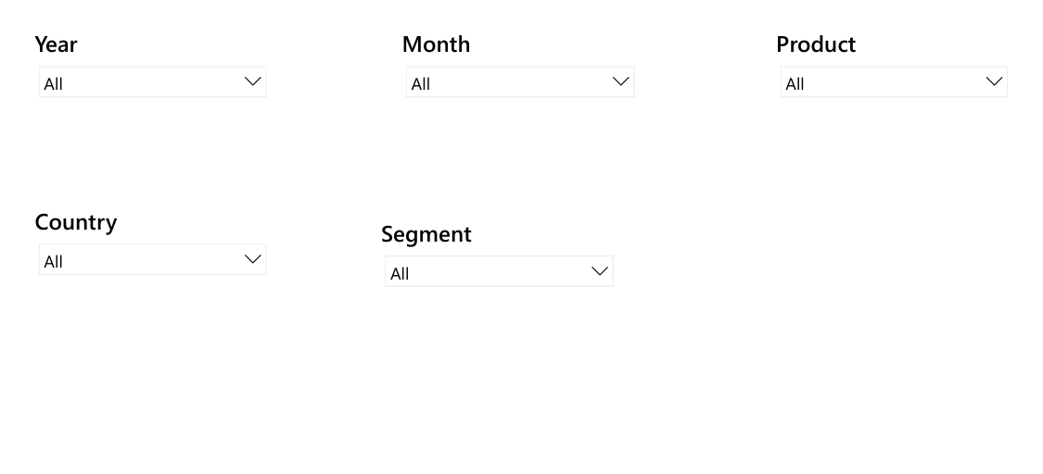
Slicer

Slide 3
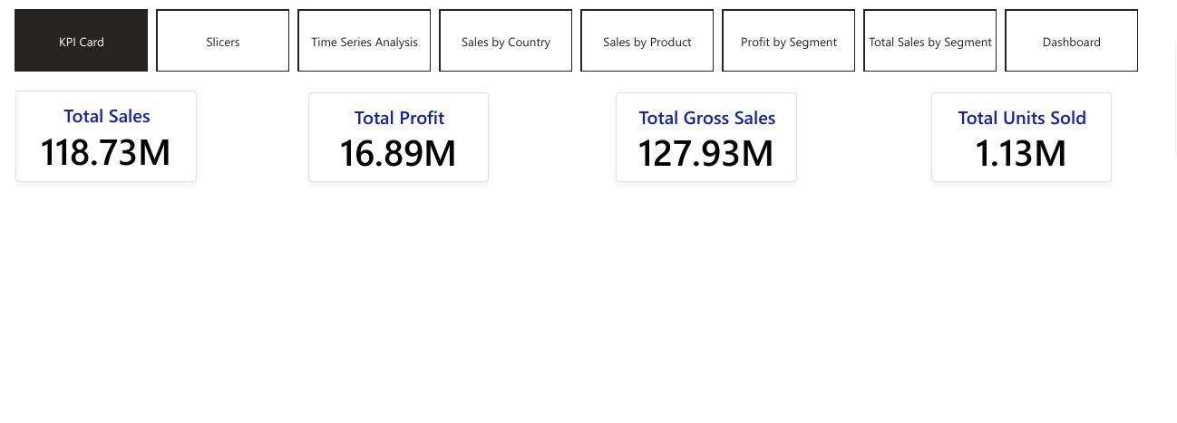
KPI Cards

Slide 4
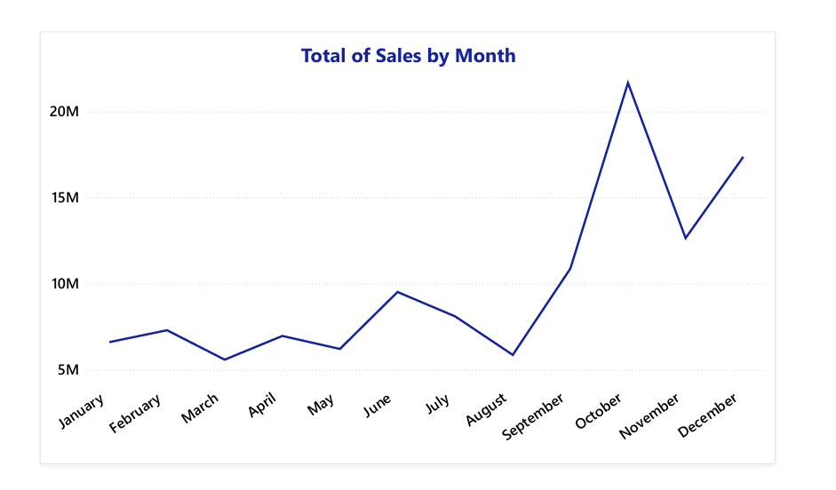

Slide 5
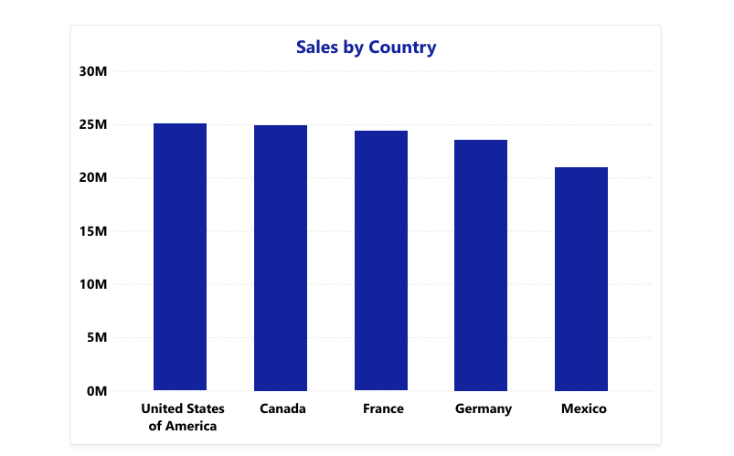

Slide 6
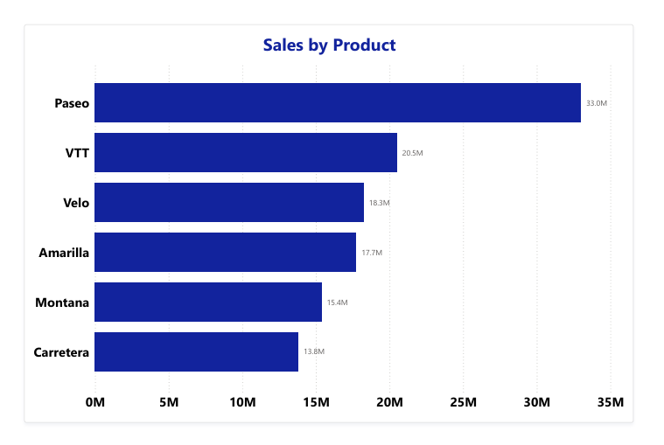

Slide 7
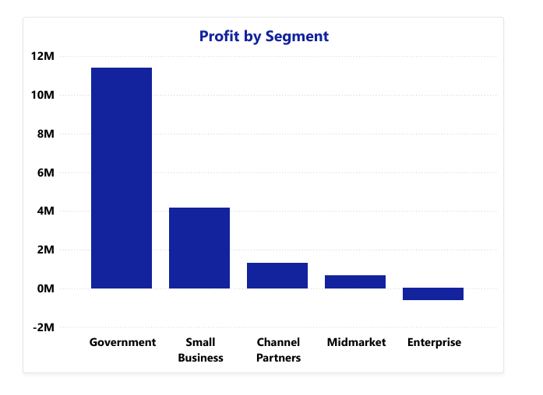

Slide 8
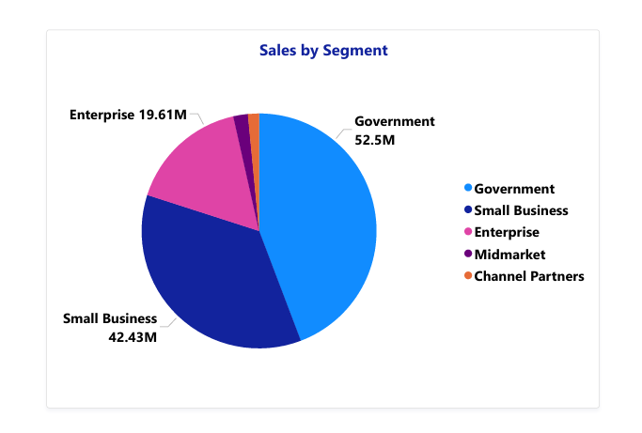

Slide 9
